Slide 1
Drone PARTS and BUDGET
IT DRONE TEAM SBMP

Slide 2
TEAM INFO
Project Guide : Abhijit Dongaonkar
Project Team :
Mihir Panchal (Team Leader) (IT) – T118
Tanay Desai (IT) – T137
Sarid Qureshi (IT) – T154
Prinkal Doshi (IT) – T107
Arshkumar Sakaria (IT) – T127

Slide 3
Drone Applications
Crop Monitoring – Agriculture
Traffic Breach – Surveillance
Medical Transport System – Healthcare
Disaster Management – Surveillance and Security

Slide 4
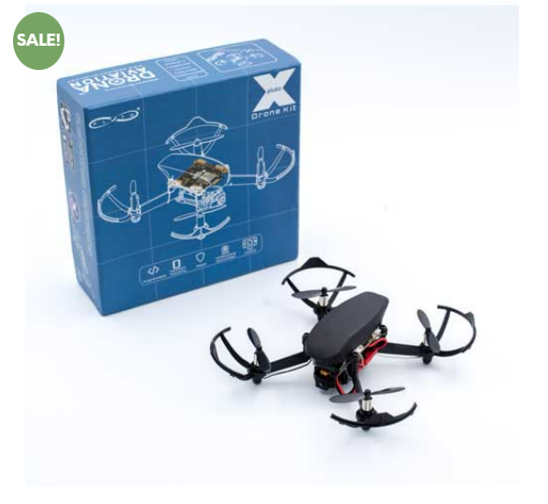
PLUTO – X Tinkerer kit

Slide 5
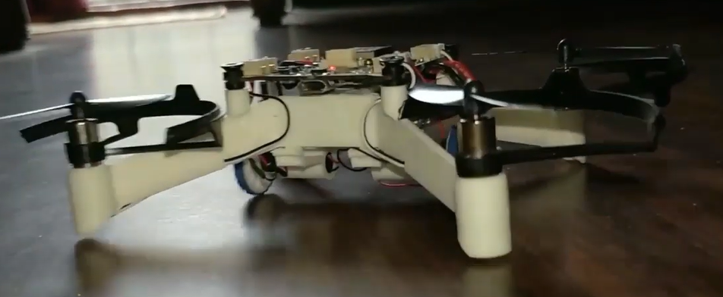
PLUTO – X Tinkerer kit
Kit Accessories
Pluto X Drone
Camera Module
X – Breakout
X - Hybrid Addon
X – Ranging Addon
2 X Laser Sensors
2 X Motors
1 set of Propellers
Propeller Remover Tool
Software Copy of Project book of experiments
Rookie Pilot Badge
https://www.dronaaviation.com/product/plutox tinkerer-kit/

Slide 6
FEATURES
Programming of the drone is easy with the Cygnus IDE.
Hybrid drone allows our application to expand at a broader scale.
Flight Controller Code is open source allowing us to make changes according to our will (https://github.com/DronaAviation).
The Kit allows guided manual of assembling the drone.

Slide 7
BUDGET
Accessories | Price
Pluto X Tinkerer Kit | 21,499
Additional Sensors | *500
Backup – (Part Repair) | *500
Total | 21499 - 22,499

Slide 8
Any question?

